Slide 1
Identifying the Best Predictive Model and Key Variables for Credit Card Default Prediction
Submitted
Manoj Nakum
Tarun Chandani
Saurav Hota
Aatrey Sathe
Sushmitha Mavuram
Rohit Singh Rawat

Slide 2
Problem Statement
Objective:
Develop and evaluate predictive models for predicting credit card defaults.
Identify the most accurate model and key variables influencing credit risk.
Enable informed lending decisions to minimize risk and optimize credit portfolios.
Challenges:
Managing imbalanced datasets where defaults are fewer than non-defaults.
Identifying significant predictors among numerous variables.
Ensuring model interpretability for practical application in credit risk assessment.

Slide 3
Importance of Credit Risk Analysis
Significance:
Credit risk analysis is crucial for financial institutions to assess the likelihood of borrower defaults.
Helps in managing credit risk, ensuring financial stability and profitability.
Predictive models aid in automating and enhancing decision-making processes, reducing human error, and improving efficiency.
Focus:
Develop and evaluate machine learning models, including logistic regression, random forest, and gradient boosting machines.
Use the Taiwan credit card default dataset for analysis to provide insights into credit risk factors.

Slide 4
Data Overview
Dataset Features
The dataset consists of 30,000 instances and 25 attributes.
Attributes include demographic, financial, and behavioral information of credit card clients.
Key columns
ID: Unique identifier for each client.
LIMIT_BAL: Credit limit in NT dollars.
SEX: Gender (1=male, 2=female).
EDUCATION: Education level (1=graduate school, 2=university, 3=high school, 4=others).
MARRIAGE: Marital status (1=married, 2=single, 3=others).
AGE: Age in years.
PAY_0 to PAY_6: Repayment status from the previous six months.
BILL_AMT1 to BILL_AMT6: Bill statement amounts for the previous six months.
PAY_AMT1 to PAY_AMT6: Payment amounts for the previous six months.
default.payment.next.month: Default payment indicator (1=default, 0=no default).

Slide 5
Data Information
Dataset Summary
Total Rows: 30,000
Total Columns: 25
No Missing Values: The dataset is complete with no missing values.
Preprocessing
Data cleaning and preprocessing steps were applied to handle any inconsistencies.
Variables were transformed to appropriate formats for analysis and modeling.

Slide 6
Demographic Features Distribution
Sex Distribution
Male (1): 11,888
Female (2): 18,112
EDUCATION Levels
Graduate School (1): 10,585
University (2): 14,030
High School (3): 4,917
Others (4): 123
Unknown (5): 280
Unknown (6): 51
MARRIAGE Status
Married (1): 13,659
Single (2): 15,964
Others (3): 323
Unknown (0): 54
Observations :
The majority of the clients are female and university educated.
Most clients are single or married, with very few categorized as 'others'.

Slide 7
Default Distribution
Default Payment Next Month:
Default | Count | Percentage
No (0) | 23,364 | 77.88%
Yes(1) | 6,636 | 22.12%
Key Insight:
The dataset shows a significant imbalance, with a majority of clients not defaulting.
This class imbalance must be addressed during model development to avoid biased predictions.

Slide 8
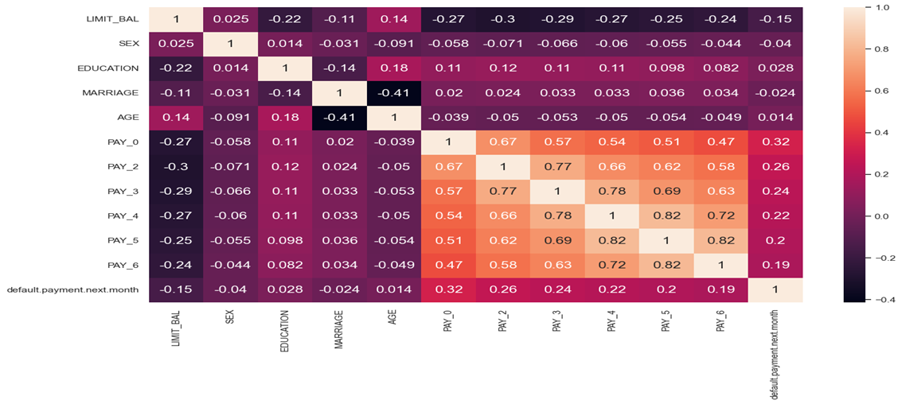
Correlation Matrix
Key Findings:
LIMIT_BAL: Negatively correlated with repayment status (PAY_0 to PAY_6) and default status, indicating higher credit limits may reduce default risk.
PAY_0 to PAY_6: Strong positive correlations among repayment statuses and with default status. Higher delinquency in payments increases the likelihood of default.
default.payment.next.month: Most correlated with PAY_0 (0.32) and PAY_2 (0.26), suggesting recent repayment behavior is crucial for predicting defaults.

Slide 9
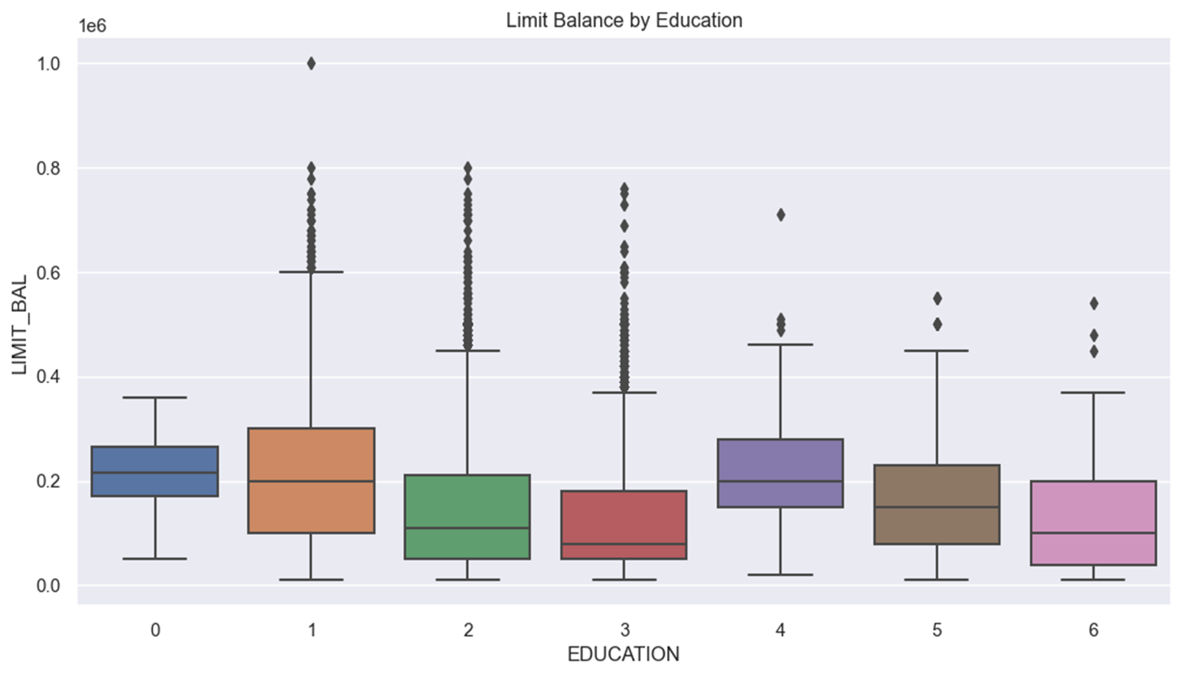
Box Plot of LIMIT_BAL by EDUCATION
Key Findings:
Education levels 1 and 2 exhibit the highest and most variable credit limits, with many outliers indicating substantial variability and some very high credit limits.
Education levels 0, 3, 4, 5, and 6 show more consistency with lower and narrower ranges of credit limits, suggesting less variability and generally lower credit limits.

Slide 10
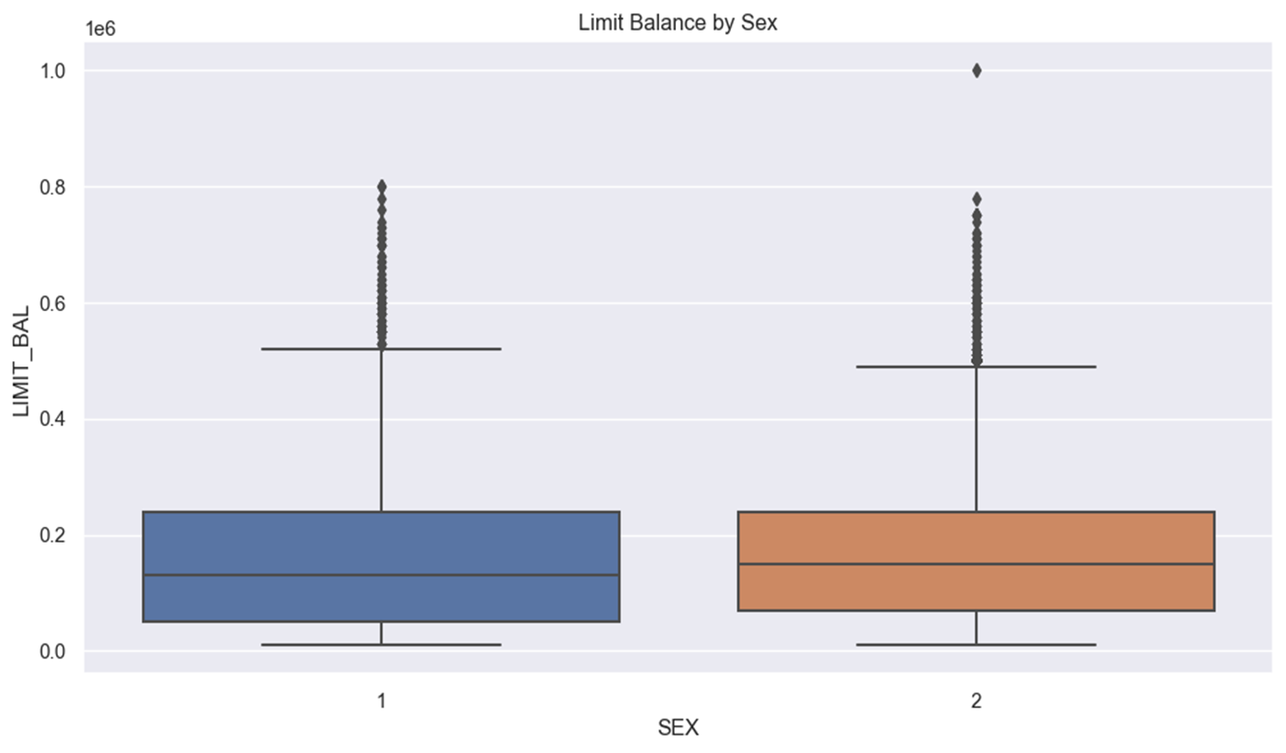
Box Plot of LIMIT_BAL by SEX
Key Findings:
Both genders have similar median credit limits, but gender 1 exhibits a broader spread and more extreme outliers compared to gender 2.
Gender 2 has a slightly narrower interquartile range, indicating less variability in credit limits and fewer extreme outliers than gender 1.

Slide 11
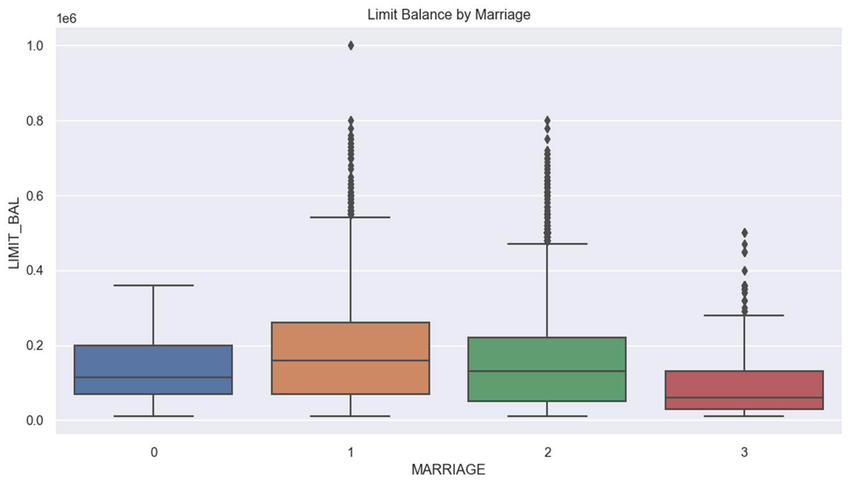
Box Plot of LIMIT_BAL by MARRIAGE
Key Insights:
Married (1) and single (2) individuals have higher and more variable credit limits, with numerous extreme outliers.
Unknown (0) and other (3) marital statuses show lower median credit limits with less variability and fewer extreme outliers.

Slide 12
Preprocessing Steps
Handling Unexpected Values:
EDUCATION: Combined categories 5, 6, and 0 into a single 'Others' category (4) for consistency.
MARRIAGE: Merged category 0 into 'Others' (3) to simplify the dataset.
PAY_n Variables: Investigated values -2 and 0, mapped appropriately to ensure accurate representation of repayment status.
Treatment:
For the EDUCATION variable, which we treat as ordinal, we found unexpected values (5, 6, and 0) in addition to the expected values (1, 2, 3, and 4) specified in the data description. We've decided to consolidate values 5, 6, and 0 into a single category (4), representing 'other'.
Similarly, in the PAY_n variables, which are also treated as ordinal, we encountered unexpected values (-2 and 0).

Slide 13
Feature Engineering
Steps:
We have added 4 new features -
CREDIT_UTILIZATION: This feature captures how much of the credit limit is utilized by the customer. Higher utilization may indicate financial stress, which could be a predictor of default.
AVG_PAYMENT: This feature calculates the average payment made by the customer over the last six months. Consistent payments may indicate a lower risk of default.
PAYMENT_INCOME_RATIO: This ratio measures the proportion of the bills that are being paid. A higher ratio suggests better financial management, reducing the likelihood of default.
NUM_DELAYED_PAYMENTS: This feature counts the number of months the customer has delayed payments. More delays indicate higher risk of default.
Normalization and Scaling: Ensured all numerical features are on a similar scale using StandardScaler.
Handling Class Imbalance: Employed oversampling technique, SMOTE (Synthetic Minority Over-sampling Technique) to balance the dataset.
Objective:
Enhance model performance and ensure balanced representation of both default and non-default cases.

Slide 14
Model Development
Models Evaluated:
Logistic Regression: Baseline model known for interpretability and simplicity.
Random Forest: Ensemble model leveraging multiple decision trees for robust predictions.
Decision Tree: Simple model that splits the data based on feature values.
Gradient Boosting Machines: Iteratively improves model accuracy through gradient descent.
XGBoost: An optimized gradient boosting framework known for high performance.
Approach:
Split data into training and test sets (80/20) to validate model performance.
Used cross-validation to tune hyperparameters and avoid overfitting.

Slide 15
Model Development
Logistic Regression:
Accuracy: 74%
Precision: 73.00% (class 0), 76.00% (class 1)
Recall: 77.00% (class 0), 72.00% (class 1)
F1 Score: 75.00% (class 0), 74.00% (class 1)
ROC-AUC: 0.8173
Random Forest:
Accuracy: 85.00%
Precision: 83.00% (class 0), 87.00% (class 1)
Recall: 87.00% (class 0), 83.00% (class 1)
F1 Score: 85.00% (class 0), 85.00% (class 1)
ROC-AUC: 0.9177
Decision Tree:
Accuracy: 76.00%
Precision: 75.00% (class 0), 77.00% (class 1)
Recall: 77.00% (class 0), 75.00% (class 1)
F1 Score: 76.00% (class 0), 76.00% (class 1)
ROC-AUC: 0.7566
Gradient Boosting:
Accuracy: 79.00%
Precision: 81.00% (class 0), 81.00% (class 1)
Recall: 76.00% (class 0), 76.00% (class 1)
F1 Score: 78.00% (class 0), 78.00% (class 1)
ROC-AUC: 0.8636
XGBoost:
Accuracy: 82.89%
Precision: 81.00% (class 0), 81.00% (class 1)
Recall: 80.00% (class 0), 80.00% (class 1)
F1 Score: 80.00% (class 0), 80.00% (class 1)
Objective:
Provide a comprehensive evaluation of each model's performance to identify the most effective predictor.

Slide 16
Evaluation Findings
In credit card default prediction, minimizing false negatives is crucial due to the high cost of incorrectly predicting non-defaults. Financial institutions prioritize improving recall for potential defaulters to manage credit risk effectively, even if it leads to more false positives.
Model Performance:
Random Forest emerged as the most accurate model with an recall of 87% & demonstrated strong performance with a precision of 83% and AUC-ROC Score of 91%, suggesting a good balance between identifying true positives and minimizing false negatives.

Slide 17
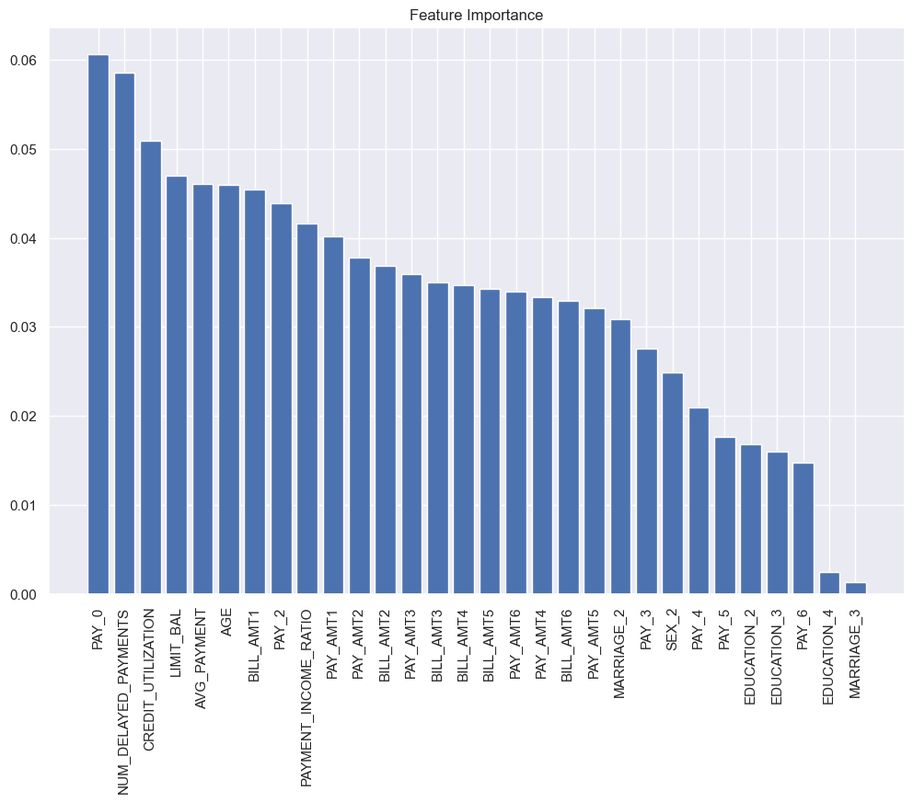
Feature Importance
The Random Forest model was identified as the best-performing model for predicting credit card default with a ROC-AUC score of 0.92. The key variables influencing the predictions were primarily related to payment history and bill amounts, highlighting the importance of timely payments and outstanding bills in determining default risk.

Slide 18
CONCLUSION
Top-Performing Models: Random Forest stand out as the best models for predicting credit card defaults, offering high recall of a good balance between precision and recall. These models provide reliable predictions, making them ideal for practical application in credit risk assessment.
Practical Implications: Implementing Random Forest models enables financial institutions to make more informed and automated credit lending decisions. This helps in identifying high-risk clients effectively, reducing default rates, and optimizing the credit portfolio.
Future Work: Future enhancements could involve further tuning of these models, exploring additional advanced algorithms, and incorporating more recent data to continuously improve prediction accuracy and robustness in credit risk management.
Project Impact
The insights and models developed in this project contribute significantly to the field of credit risk analysis. By leveraging advanced machine learning techniques, financial institutions can better manage credit risk, ensure financial stability, and enhance overall profitability.

